Slide 1
Python Data Analyst Project
Churn Data
Vestina Gurevich - 320766744
Iris Markus - 205745128
Orly Tafilay - 206016859

Slide 2
The Problem
We were trying to predict whether a customer will churn or not.
We got a Churn database that contained the following columns:
customerID, 'gender', 'SeniorCitizen', 'Partner', 'Dependents', 'tenure', 'PhoneService', 'MultipleLines', 'InternetService', 'OnlineSecurity', 'OnlineBackup', 'DeviceProtection', 'TechSupport', 'StreamingTV', 'StreamingMovies', 'Contract', 'PaperlessBilling', 'PaymentMethod', 'MonthlyCharges', 'TotalCharges', 'Churn'
The motivation for solving this problem is to see why customers are leaving and how they can be preserved.
The application that we chose was creating a data science model that can help us observe which of the parameters are connected to customer’s churn.

Slide 3
Solution Steps
Data Description
Data Engineering
ML Algorithms
Algorithms Introspection
Checking label distribution
missing values
feature quantity
Data Cleaning
Removing / Adding new features
K Nearest Neighbors
Decision tree
Random Forest
Inspecting various algorithm artifacts
Feature importance

Slide 4
01
Data Description
Checking label distribution, missing values and feature quantity
Preparing graphs that will help us understand the data

Slide 5
Data Description
20% to 80% Rule
21
73.5% Active Clients
11
Train/Test
Features
5634 examples are in the train Dataset.
1409 examples are in the test Dataset.
There are 21 features in the Original Dataset
Distribution of Lables
Missing Values
73.5% not churned (Active)
26.5% churned
There are 11 missing values under the totalcharges column

Slide 6
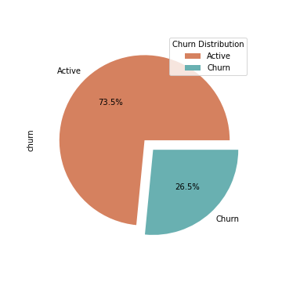
Graph Number 1 – Label Distribution
73.5%
26.5%
Active
Client that didn’t churn
Churned
Clients that did churn
We can see that most of the clients are active (73.5%).

Slide 7
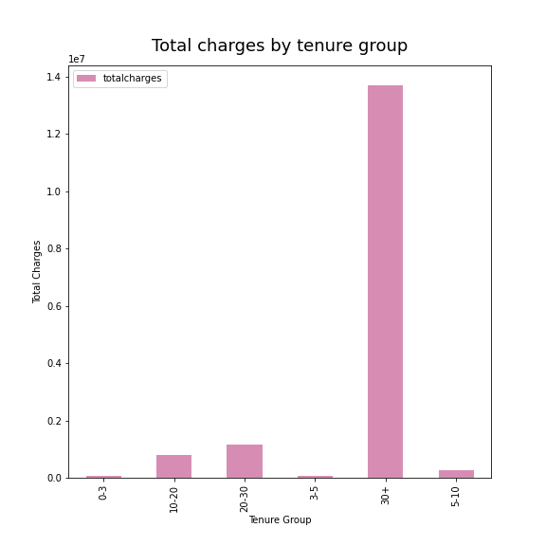
Graph Number 2 – Total charges by tenure group
13,697,484
The total charges of clients in the highest tenure group – tenure group 30+
58,158
The total charges of clients in the lowest tenure group – tenure group 0-3
The highest total charges rate belongs to clients in 30+ month tenure group.
We see how important it is to retain the customer for the long term
and take appropriate actions for this.

Slide 8
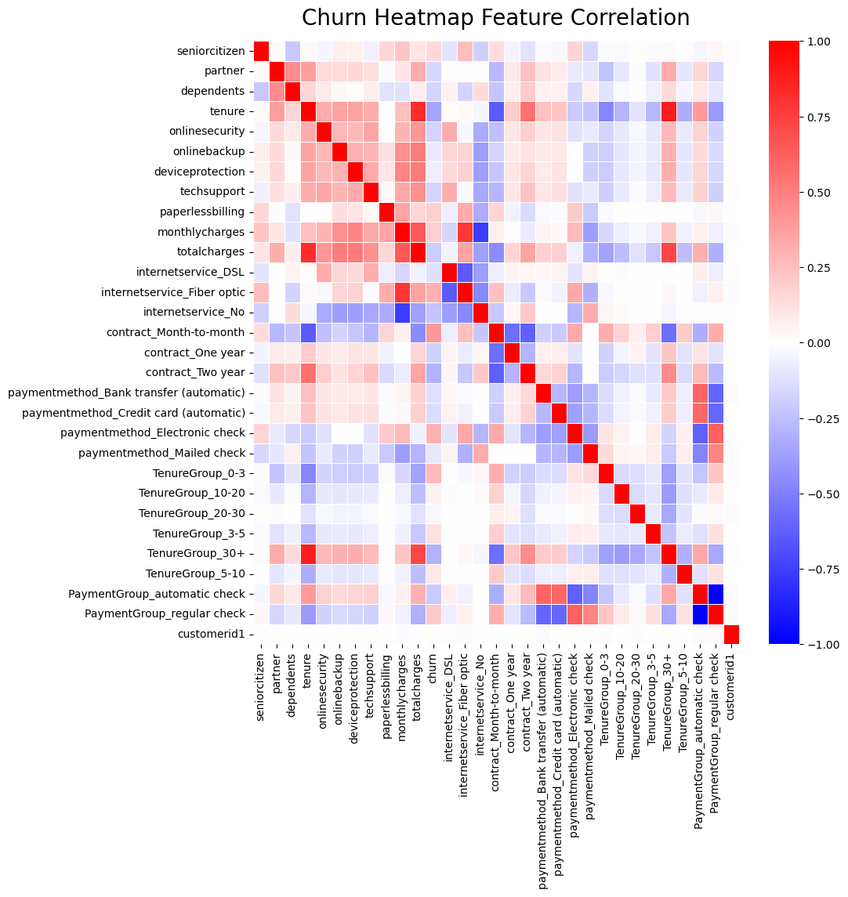
Graph Number 3 – Churn Feature Correlation Heatmap Chart
Tenure-total charges
We can see a high correlation between the parameters: total charges and tenure – correlation of 82.5%
Internetservice_Fiber_optic -monthly charges
We can see a high correlation between the parameters: internetservice_Fiber_optic and
monthlycharges - correlation of 78.7%

Slide 9
Graph Number 3 – Churn Feature Correlation Heatmap Chart
Internetservice_No – monthly charges
We can see a low correlation between the parameters: internetservice_No and monthly charges , correlation of -76.3%
Contract_month_to_month - tenure
We can see a low correlation between the parameters: contract_month_to_month and tenure - correlation of -64.5%

Slide 10
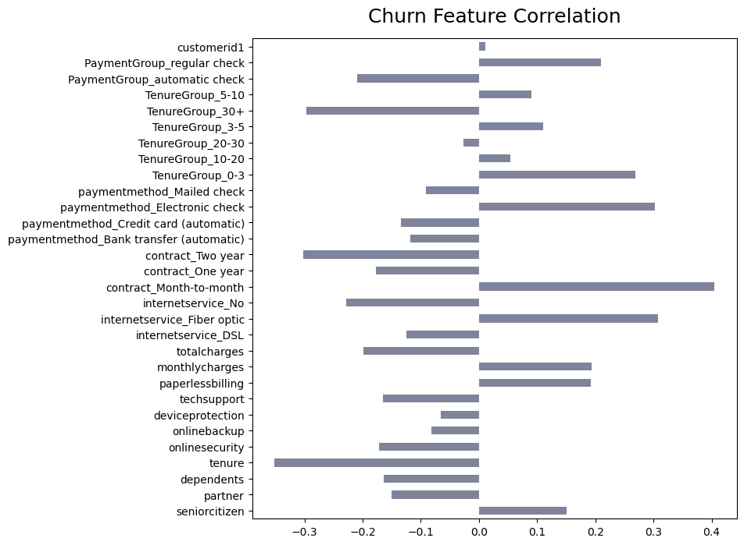
Graph Number 4 – Churn Feature Correlation
Chart
Churn Feature Correlation
We can see a high correlation between the features: contract_month_to_month, payment_method_elecgtronic_check and tenure group 0-3 To the churn rate.
We can see a low correlation between the features: tenure, contract_two_year and tenure group 30+ To the churn rate.

Slide 11
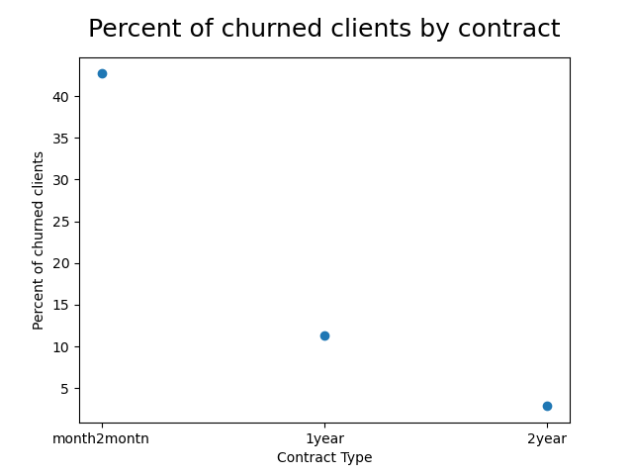
Graph Number 5 – Percent of churned clients by contract
We can see that clients with payment contract of month-to-month have higher churn rate in comparison to one-year or two-year contracts.

Slide 12
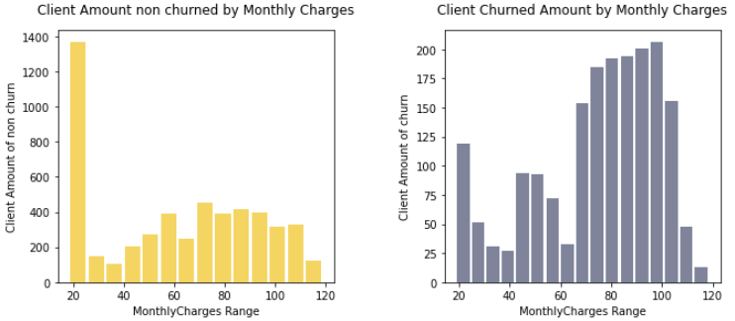
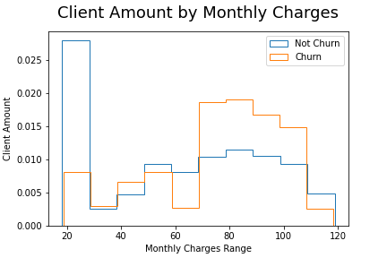
Graph Number 6 – Comparison - Client Amount by Monthly Charges
not normalized - clients amount in non-churned is much higher.
With normalization of clients amount
We can see that the monthly charges range of most of the clients that didn’t churn was 0-20$, while the monthly charges range of most of the clients that did churn was 70-110$.

Slide 13
02
Data Engineering
Removing / Adding new features
Explaining how we treat missing values

Slide 14
Data Engineering – Process Explanations:
We decided to remove the customerId column, since it made a disruption when we activated the pd.get_dummies() method.
After checking the correlation, we decided to remove the following features: 'gender','multiplelines','phoneservice','streamingtv','streamingmovies’
We added a tenure group distribution column.
We added a column that defines if the customer conducted a regular/ automatic payment – the ‘PaymentGroup’ column.
We decided to fill the missing values of the ‘totalcharges’ column by the median value of the entire column.

Slide 15
03
ML Algorithms
Testing the following machine learning algorithms:
K Nearest Neighbors
Decision tree
Random Forest

Slide 16
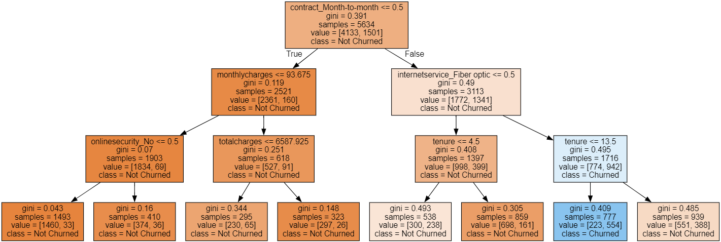
Decision Tree Classifier
By the gini score we can determine that the best splitter of the decision tree is the feature contract_month_to_month.

Slide 17
04
Algorithm Introspection
Inspecting various algorithm artifacts
Feature importance

Slide 18
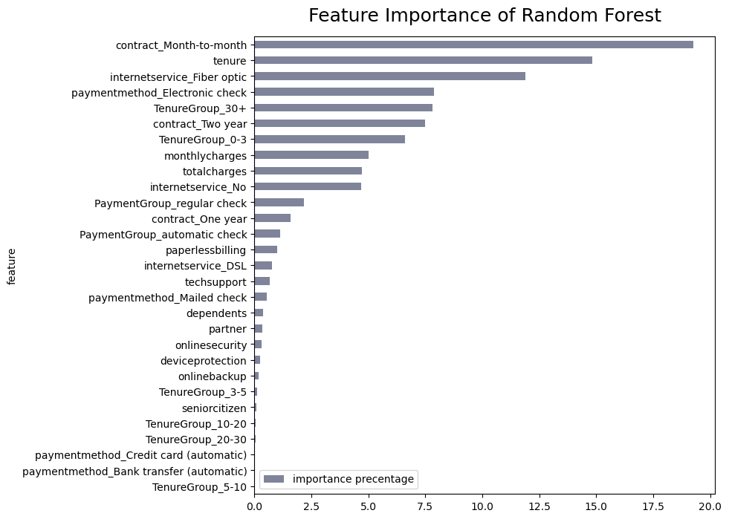
Random Forest – Feature Importance
The most important feature is: contract_month_to_month with feature importance of: 21.2%
The least important feature is: paymentmethod_Credit card (automatic)
with feature importance of: 0.002%

Slide 19
Initial Accuracy Scores
77.8%
77.7%
74.3%
Decision Tree
Randon Forest
KNN
By the initial accuracy score, we can see that the best model is Decision tree

Slide 20
Decision Tree – Overfitting
 | Max Depth | Accuracy score
1st try | 5 | 78.4%
2nd try | 6 | 78.0%
3rd try | 4 | 77.2%

Slide 21
Random Forest– Overfitting
 | Max Depth | N estimators | Accuracy score
1st try | 3 | 100 | 77.7%
2nd try | 5 | 100 | 78.8%
3rd try | 7 | 100 | 79.8%
4th try | 3 | 200 | 77.7%
5th try | 7 | 81 | 80.1%

Slide 22
K Nearest Neighbors– Overfitting
 | N neighbors | Accuracy score
1st try | 3 | 74.3%
2nd try | 5 | 75.5%
3rd try | 8 | 77.1%
4th try | 10 | 77.7%
5th try | 20 | 77.0%

Slide 23
05
Conclusions

Slide 24
1.
In the churn analysis we saw clearly the importance of retaining clients with tenure group of more than 30 months – total charges from long term clients is higher from other tenure groups.
2.
It seems better to encourage clients to sign with 1\2 years contract and not month-to-month payment, because clients with 1\2 year contract are less likely to churn.
3.
It may be a good idea to check and limit the monthly payment sum of clients,
As there is a big increase in clients churn rate when the monthly payment is getting higher than 70$.

